Slide 1
Neuropythy for Dev
Neurohackademy 2019
Maya Rosen, Kendra Seaman, Aarti Nair,
Megan McMahon, Leehyun Yoon

Slide 2

The Plan
Download the HCP-Lifespan
Run HCP preprocessing pipelines using a docker container on AWS
Use neuropythy to retrieve and visualize age-related differences in structural properties:
cortical thickness
gyrification
T1/T2 differences

Slide 3
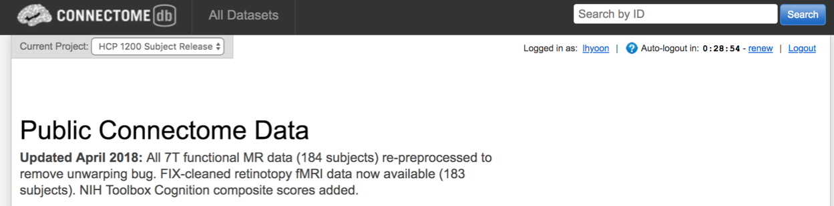
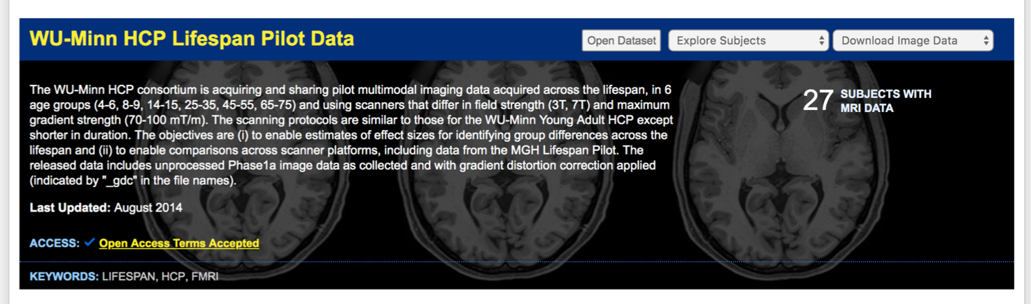
Monday: Download the HCP-D and HCP-A Datasets

Slide 4


Tuesday: Upload the data to AWS and run the HPC Pipeline

Slide 5

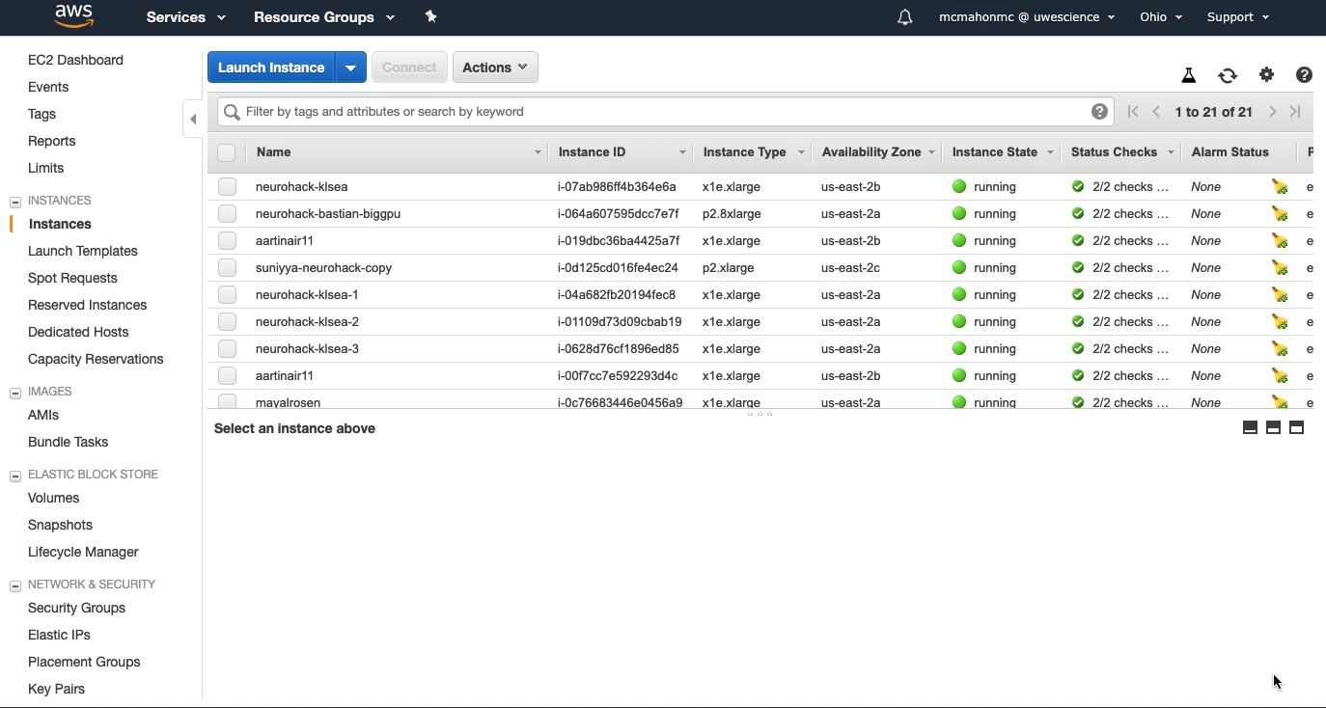
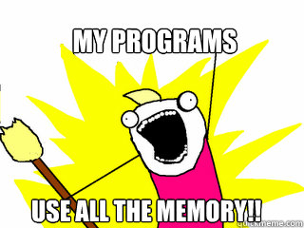
Wednesday: BIDS the data and run the HPC Pipeline

Slide 6
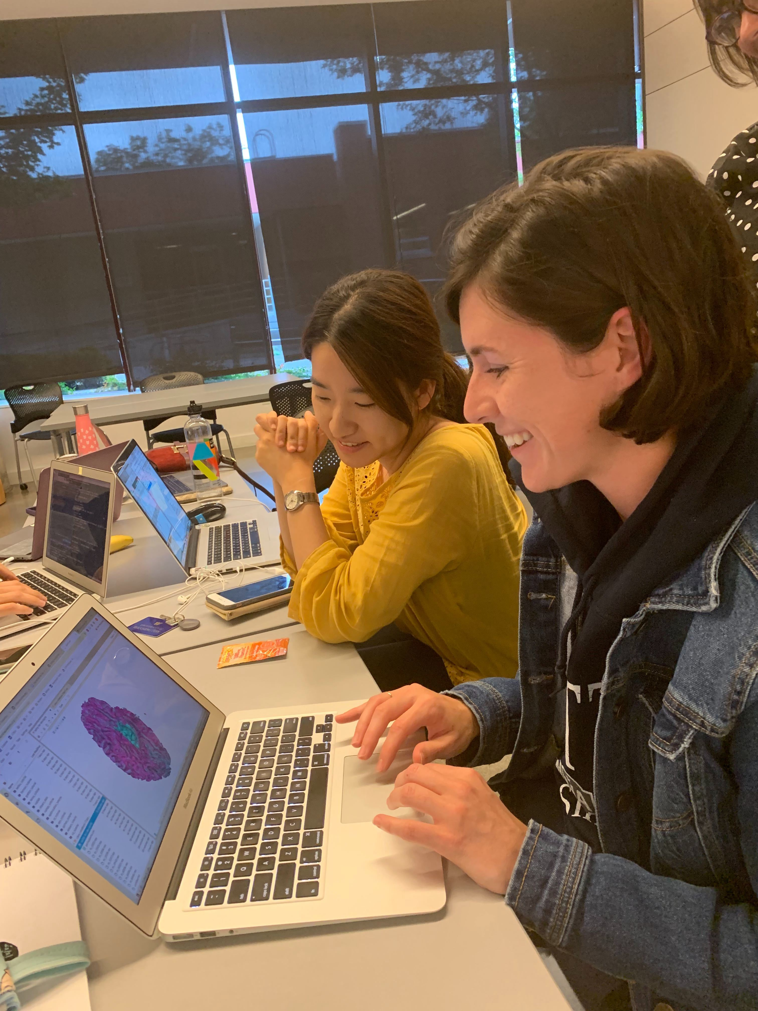
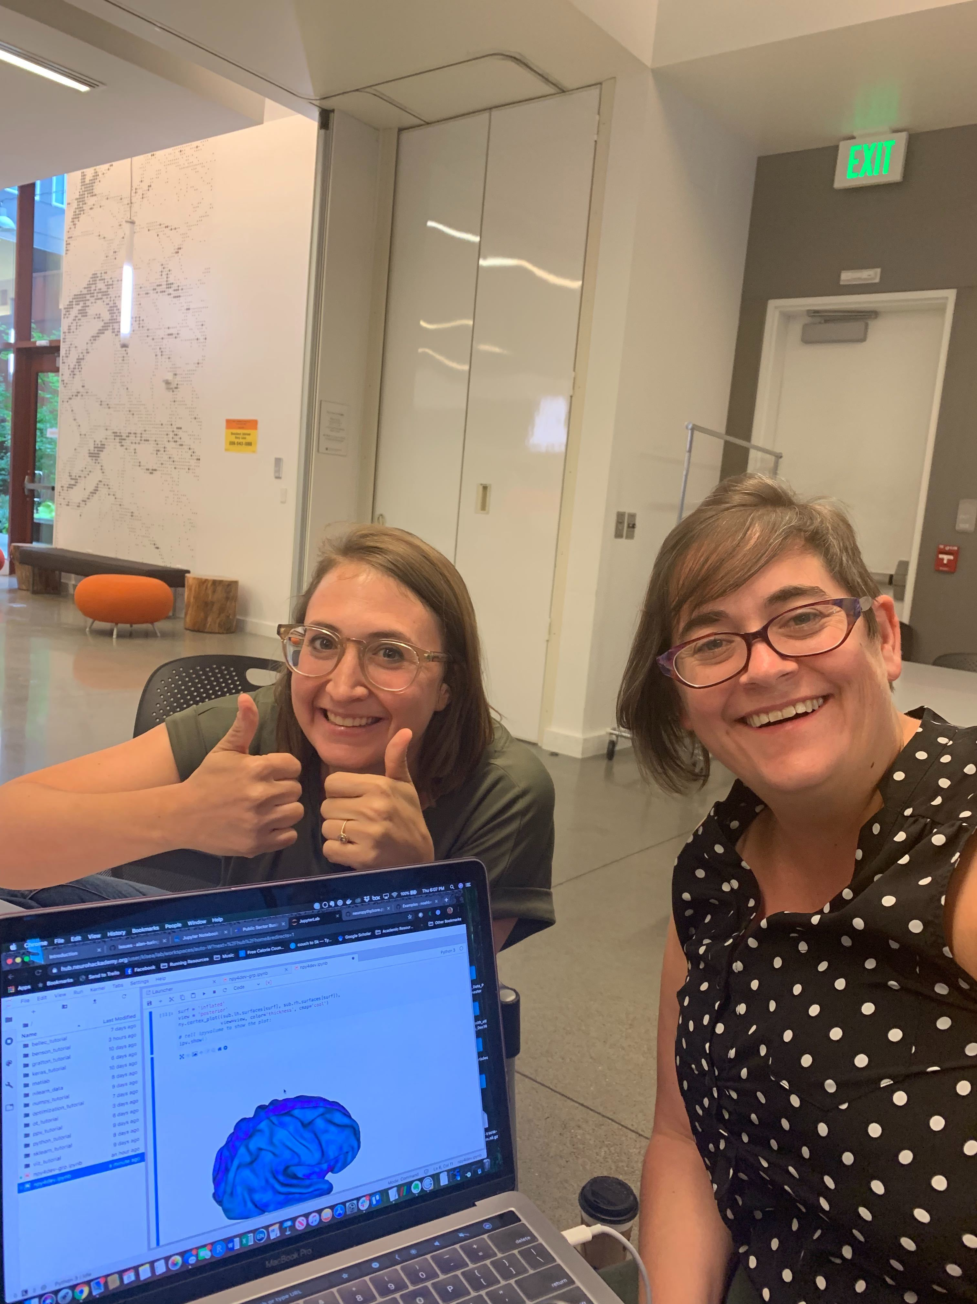
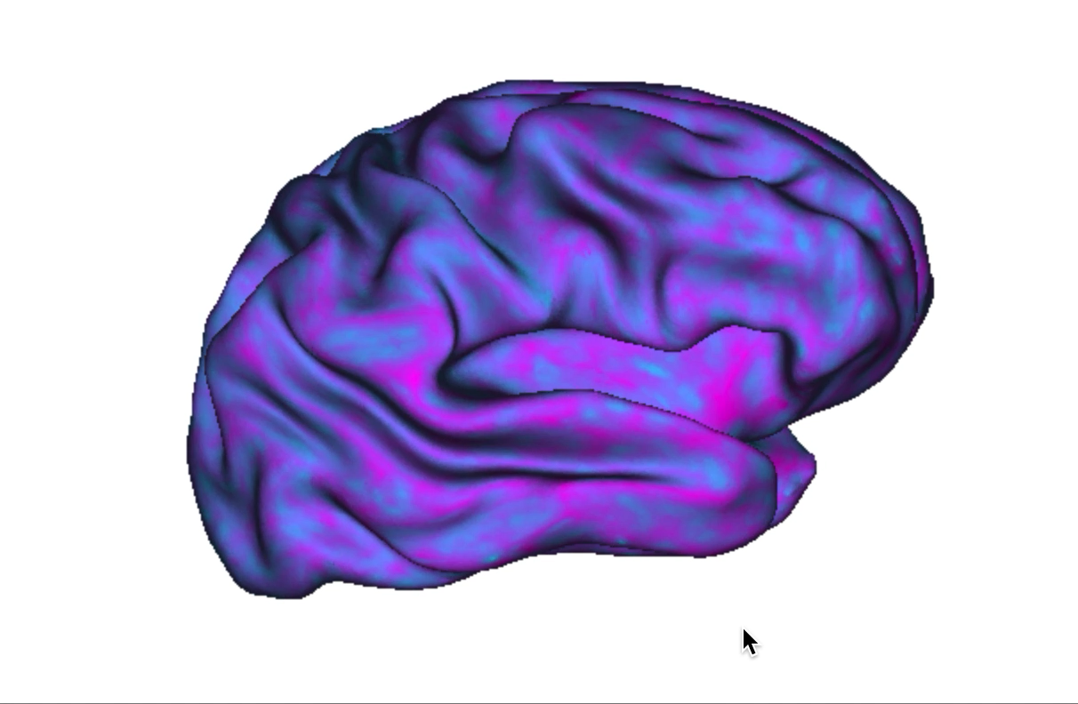
Thursday: Look at a single subject in Neuropythy

Slide 7

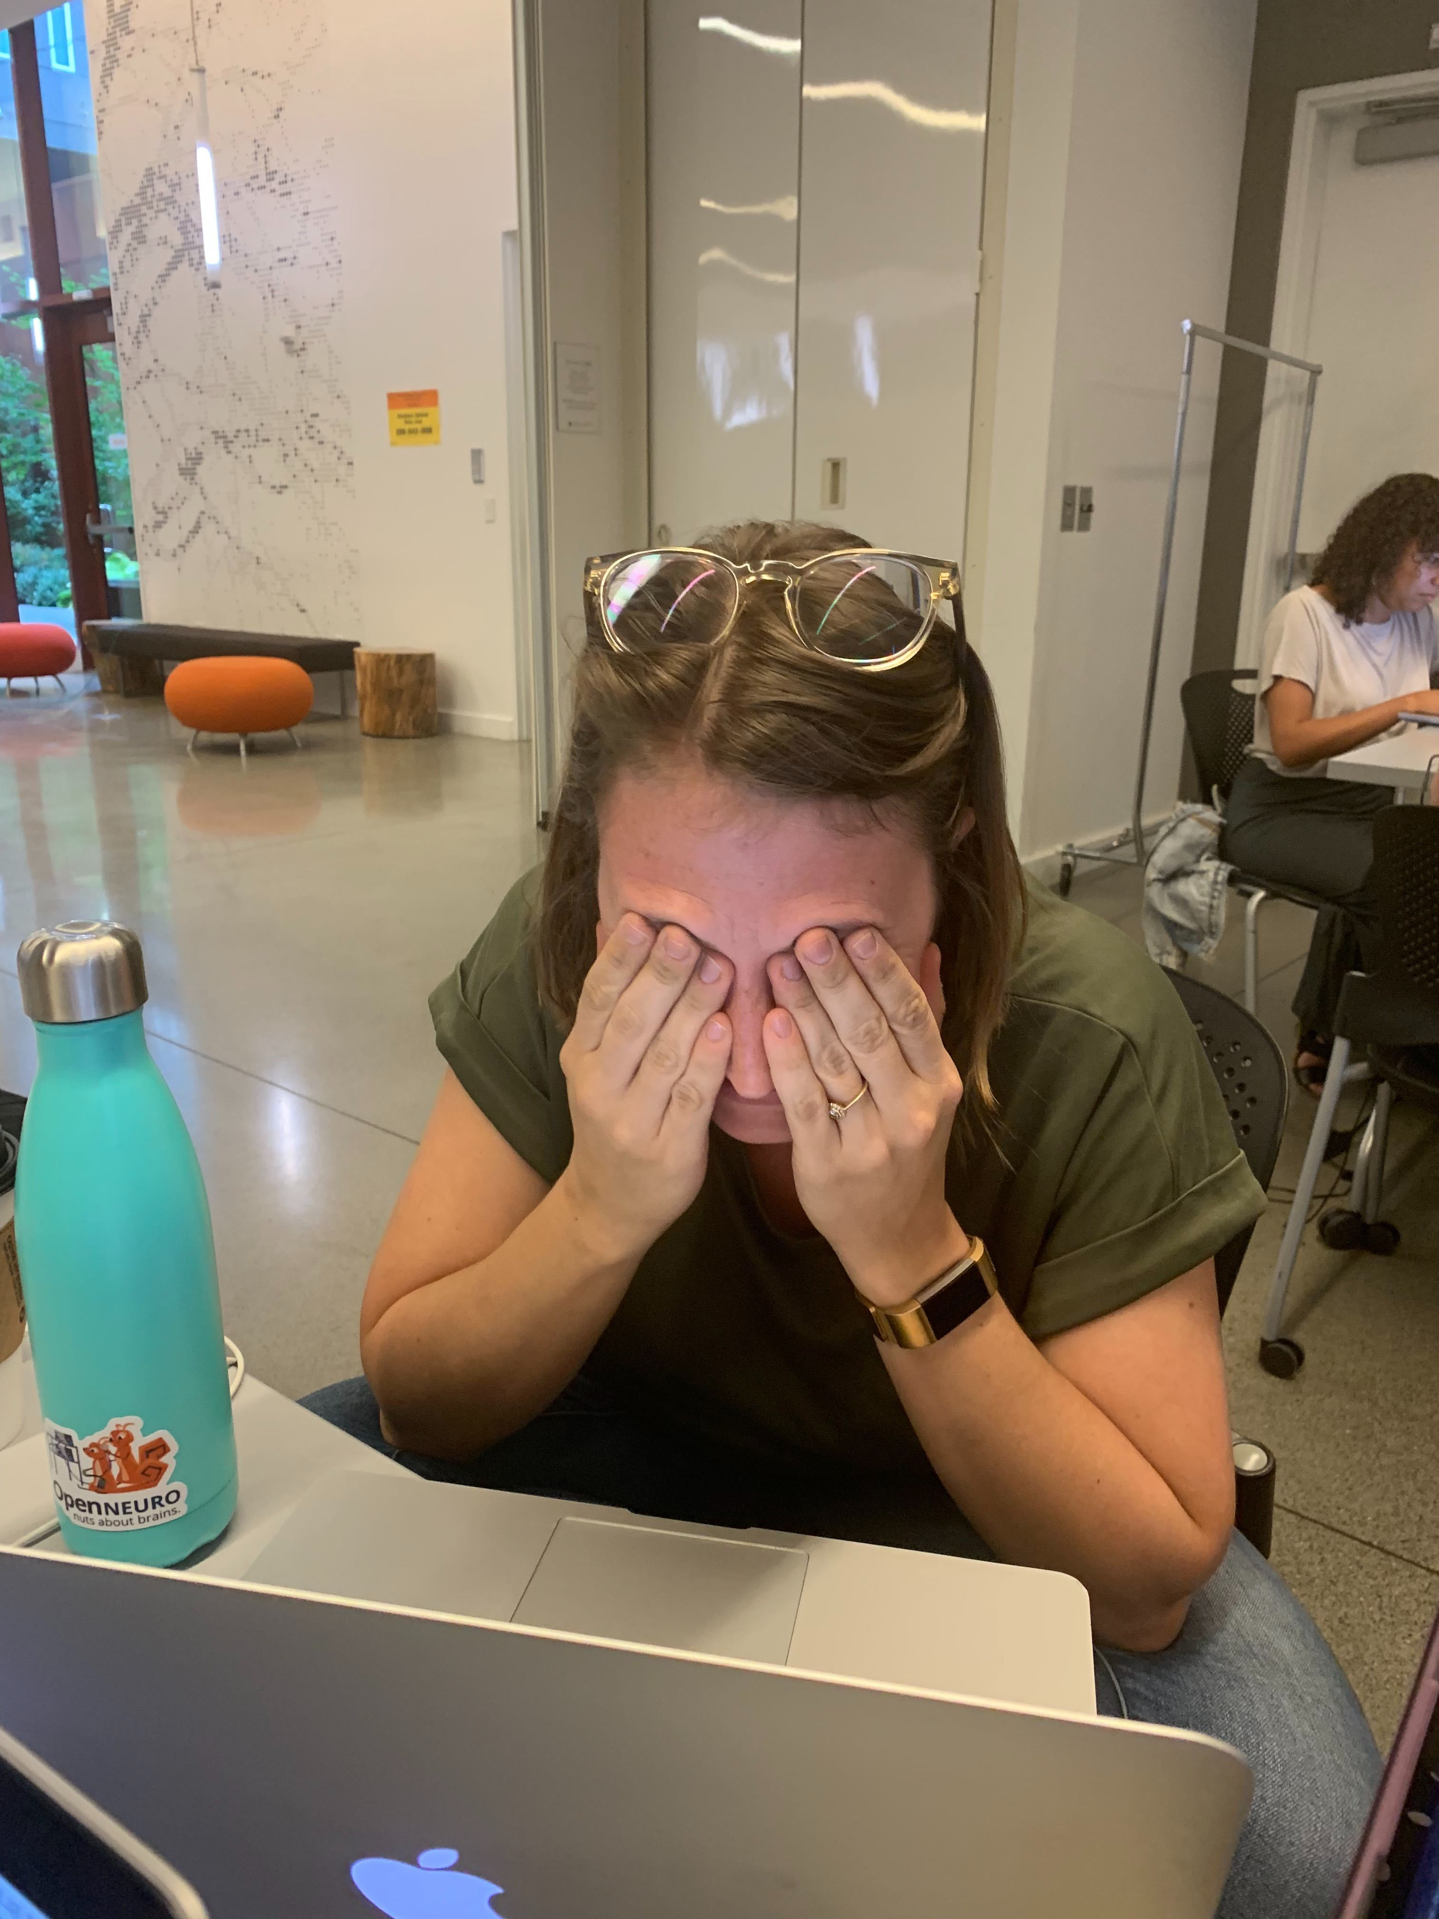
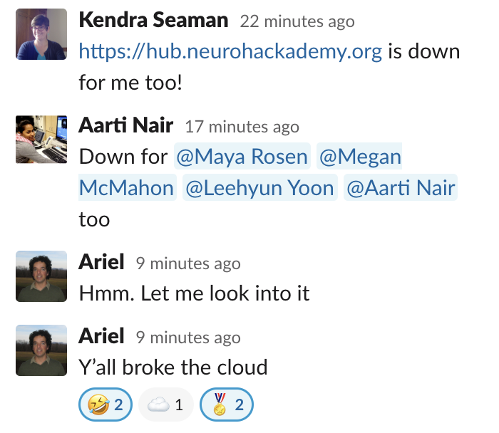

Thursday: Run group-level analyses in Neuropythy… or anything
!

Slide 8
Friday:

Slide 9
THE END

